Slide 1
Parallelization of Scientific Realtime Generative AI Response Verification System for Continuous Quality Assurance in Safety-Critical Software
Kae Sawada
EE/CSCI 451: Project Presentation
University of Southern California

Slide 2
Goal
Develop a parallelized realtime verification system that leverage panel of LLM (Large Language Model) – continuous quality assurance for safety-critical applications
Scalable
Efficient
Performant (Speed)
Cost effective
Resource preserving

Slide 3
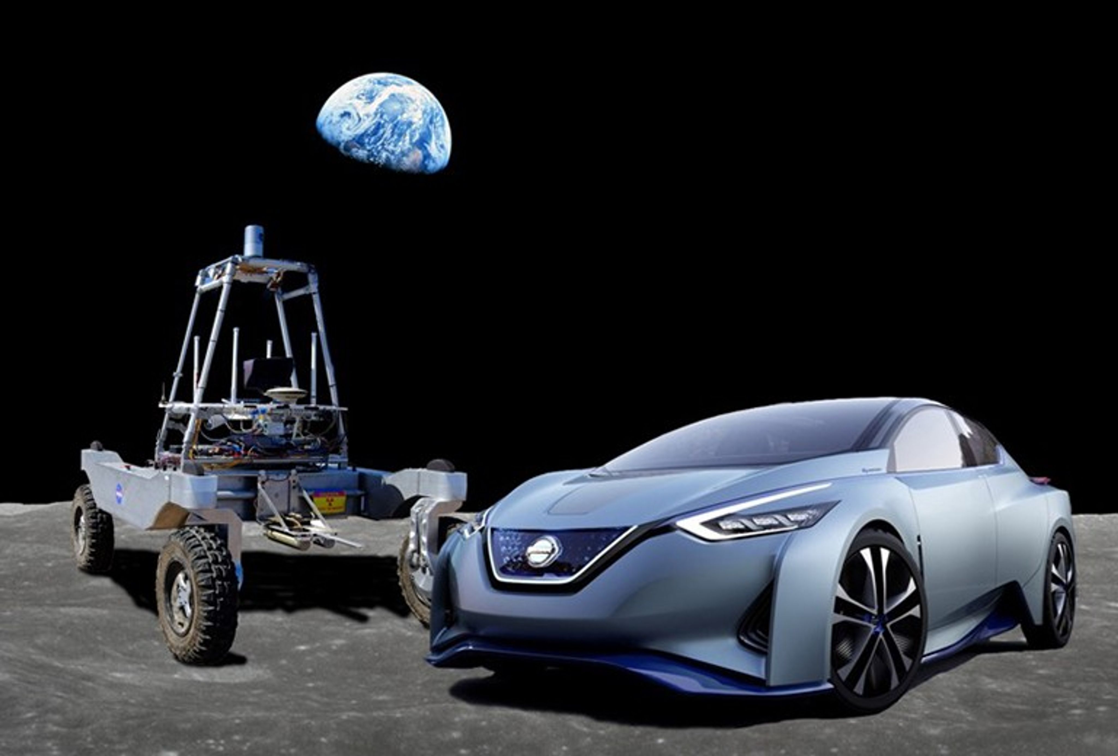
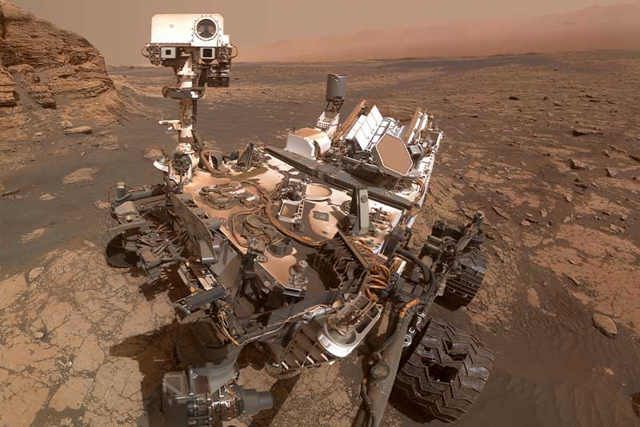
Introduction
Autonomous vehicles require evaluation of multiple sensor data at millisecond or less intervals. Redundant verification systems are sued for such processes. Verification of each data analysis has to happen rapidly. All AI driven process, in fact, will be analyzing large volumes of data.
Manual system verification done by human operator is expensive and time consuming
An autonomous verification system is thus required.
Many types of AI verification methodology have been developed.
Internal process verification will determine that the AI’s output is aligned as expected. This doesn’t mean though that the AI’s answer is correct or on topic.
Other external verification processes usually require human intervention. Thus, such verification processes are time consuming.
https://images.app.goo.gl/Vj9y5FArpLH4G45B6
https://images.app.goo.gl/smEL8DPewZNBkTYR8

Slide 4
Context
To further increase the alignment of the primary LLM, yet another AI arbiter is added to evaluate the entire processes.
Increasing the speed at each stage is essential.
Streaming data processing, preprocessing can be parallelized (Work to go)
Query to individual LLM can be parallelized
Data aggregation can be done through MPI reduce
.

Slide 5
Context
By using role-based multi-agents within an AI a primary AI’s product can be assessed by a panel of other independent AI’s.
Each LLM will be of a different construct. The individual models of the panel simply state whether they agree or disagree with the Primary AI’s conclusion.
The percentage of agreement can be used as an evaluation of the Primary’s result.

Slide 6
Problem Statement
A verification system for an AI-assisted outer space mission operation must ensure low-latency, real-time assurance of the health and alignment of AI-generated responses. Such a system should operate efficiently, preserving computational resources while meeting the stringent demands of safety-critical environments.
Minimizing the system’s response time requires distributing the query tasks to multiple LLM agents to gain sufficient speedup.
Requires balanced speedup gains with resource utilization and parallelization overhead
Space rovers require frugal resource
Notes:
The project aims to measure predictable performance gains through task parallelization while addressing variability in agent execution times and communication overhead.

Slide 7
Hypothesis
Task-level parallelism, applied to the proposed multiple LLM verification system can yield cost effective (computational resource ) near-linear speedup on a single multicore system.
Performance metrics:
speedup
throughput
resource utilization
demonstrate predictable gains up to the number of processes, with diminishing returns as number of processes increases
Notes:
Should the 3rd layer not communicate at all (no message passing), and just update the shared memory for the result aggregation? – yes from Sachini
This project specifically focuses on:
Evaluating speedup and scalability for up to four agent on a single-node multicore system.
Mitigating load balancing issues arising from thread execution time variability.
Measuring the impact of communication and aggregation overhead on overall performance.

Slide 8
Key idea
Boost the Feasibility of your AI enhanced software innovation to the funders and stakeholders.
Safety Critical Stakeholders:
DOD
Department of Energy
Medical industry
Aerospace

Slide 9
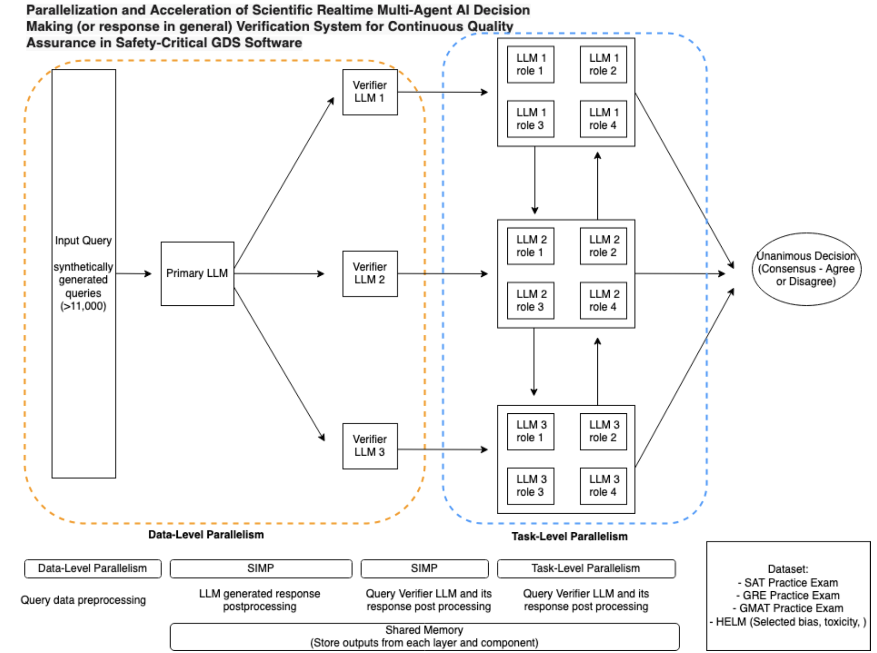
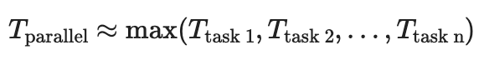
Description of the Implementation
Task Level Parallelism
Shared Memory
Message Passing

Slide 10
Description of the Implementation
Task Level Parallelism
Data Level Parallelism
Theoretical Performance Bounds
Amdahl’s Law
Gustafson’s Law

Slide 11
Description of the application:11 2 Verification Layers
2nd layer
Independent opinions from each LLM
Like doctor’s second opinions
3rd layer
Panel of Arbiters
role play

Slide 12
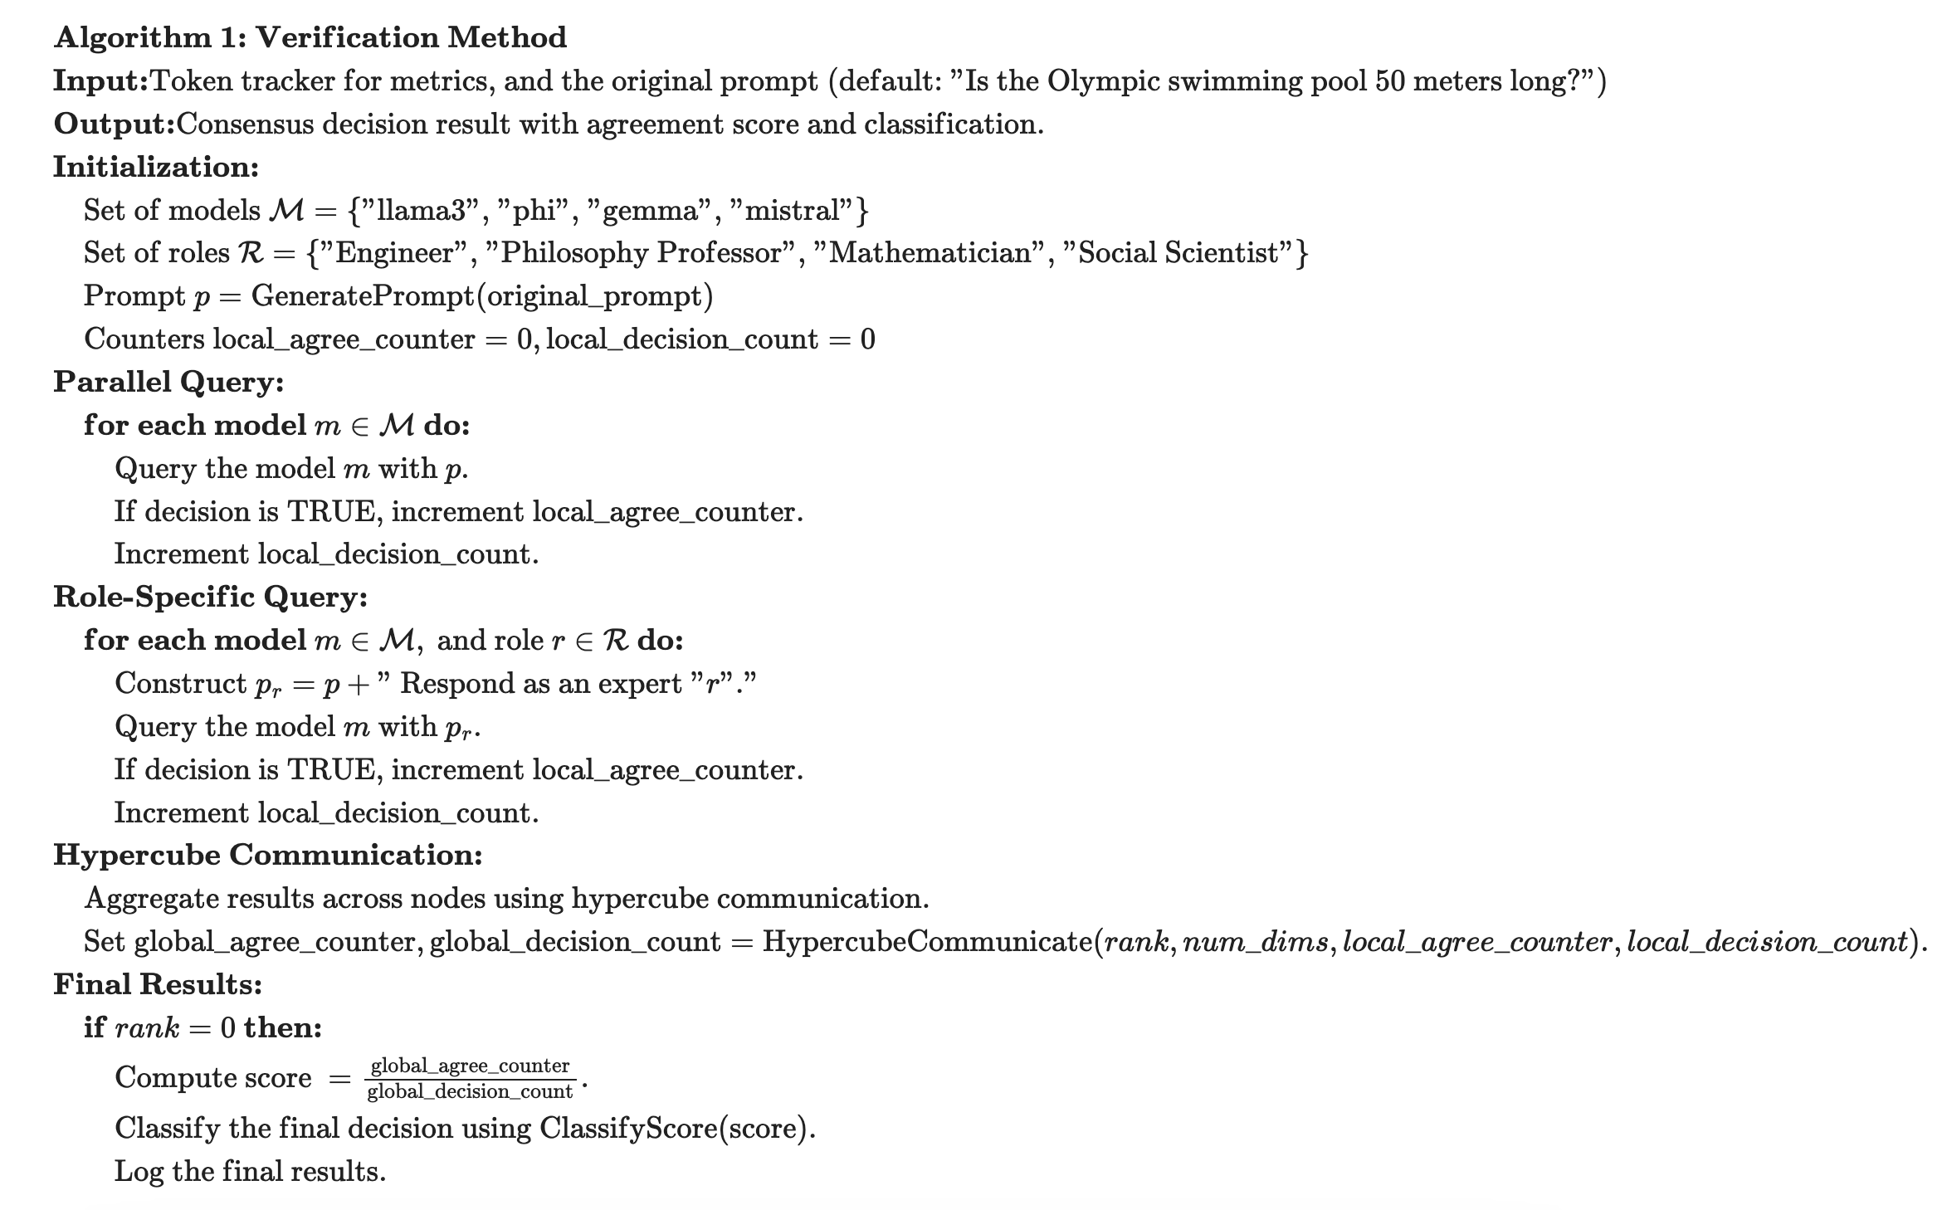
Algorithm 1 - Verification

Slide 13
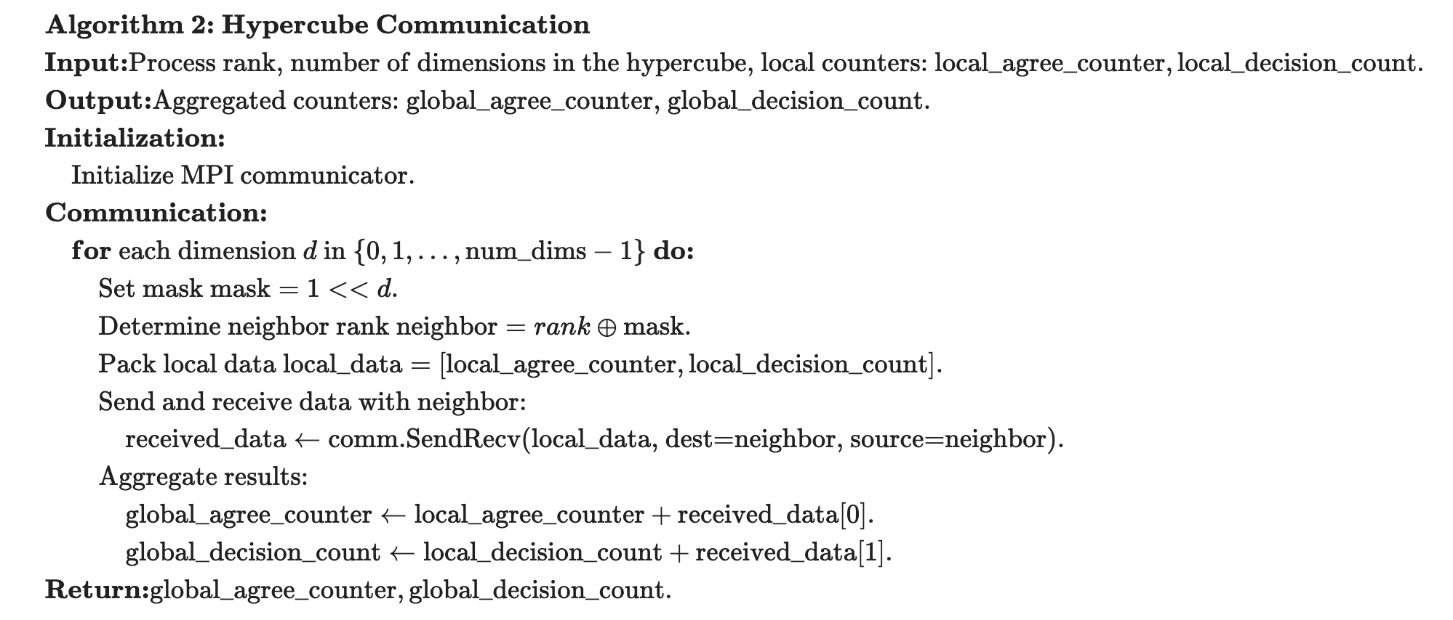
Algorithm 1 – Hypercube Communication

Slide 14
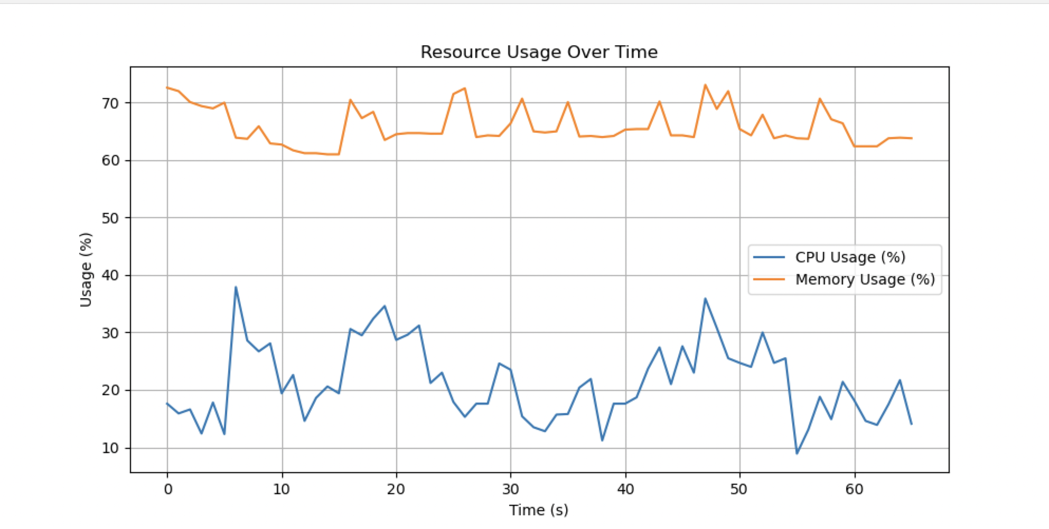

Slide 15
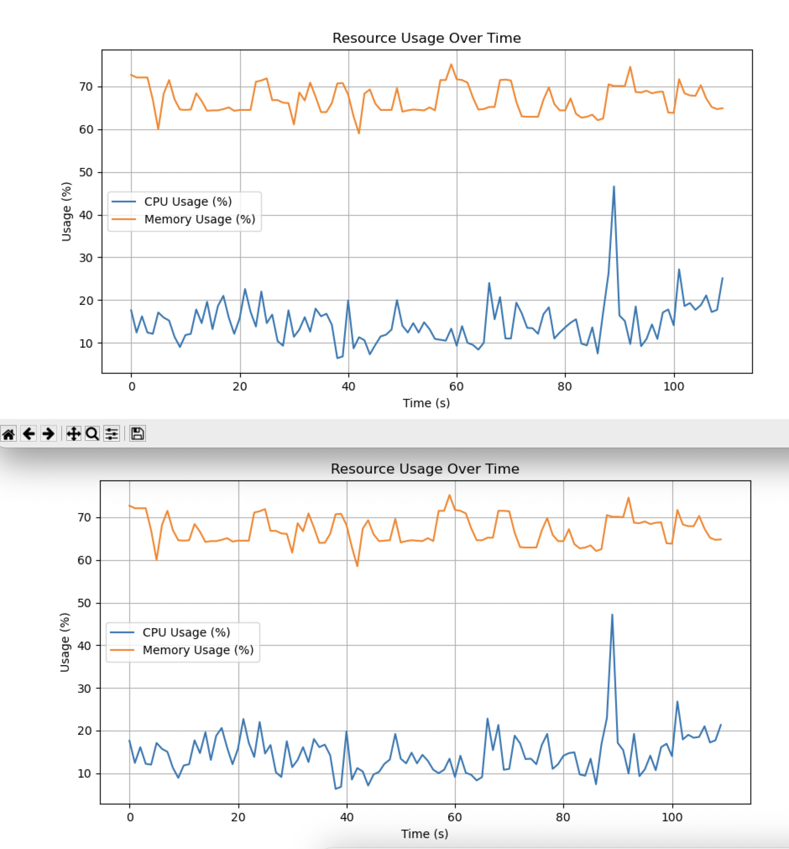

Slide 16
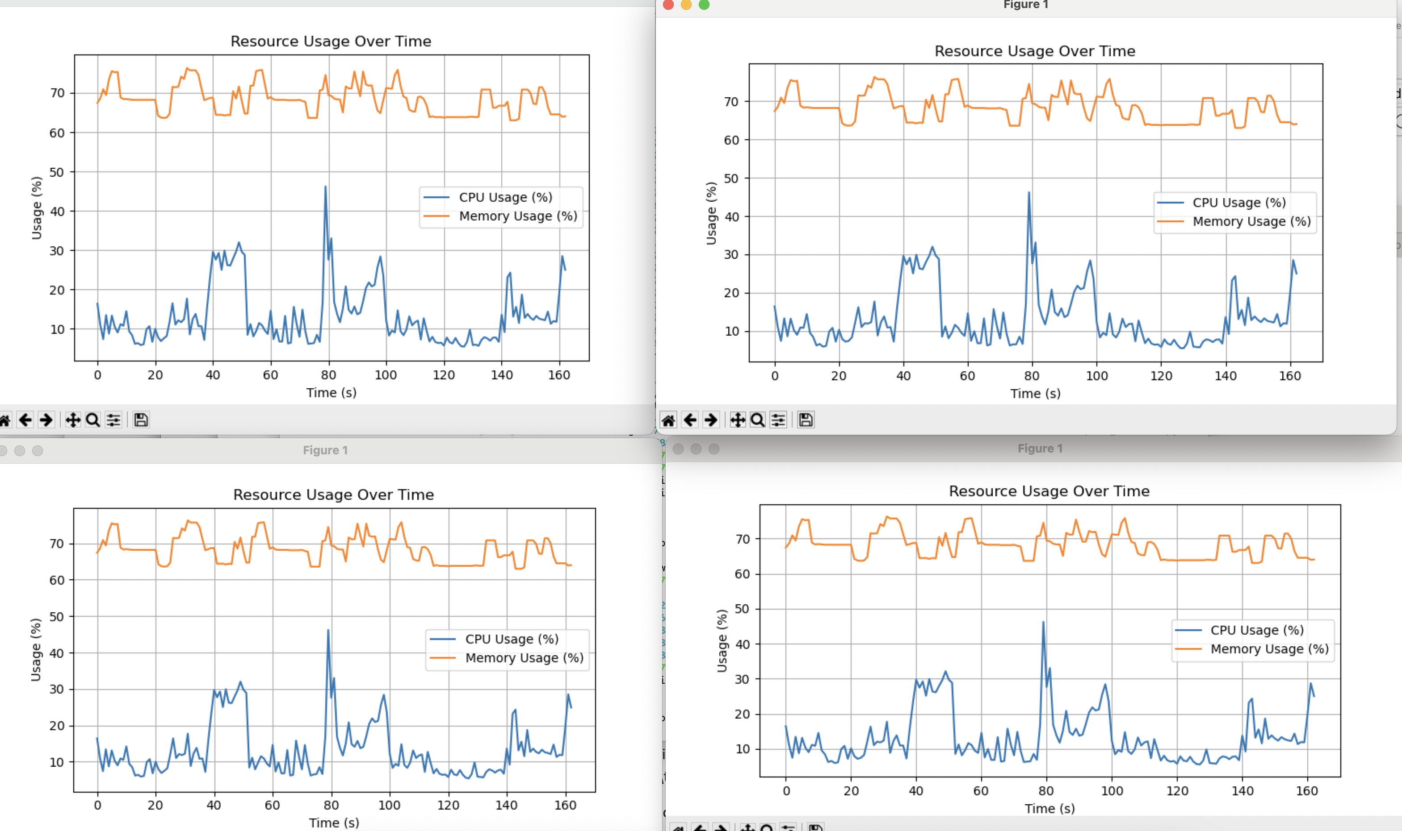

Slide 17
Description of the application: What Do the Models Verify?
Semantic Coherence
Fact Checking
Academic Performance
Social Acceptance (Bias, Fairness, etc)

Slide 18
Metrics to Obtain
Serial vs parallel
Execution Time
Tokens Processed per Second (Throughput)
Cores
Measure performance on different # of cores
Monitor # GPU/CPU/memory utilized
Simple custom script

Slide 19
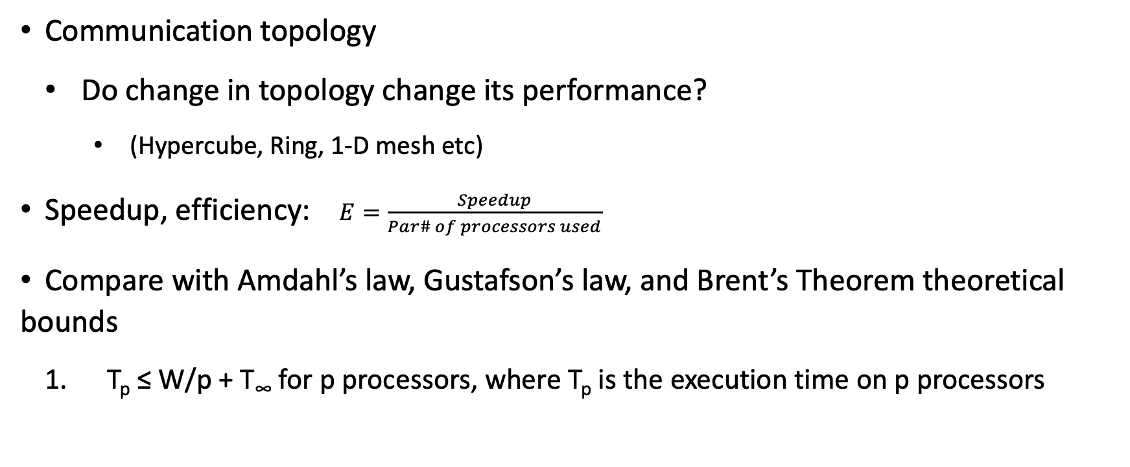
Metrics to obtain (cont.)
Communication topology
Do change in topology change its performance?
(Hypercube, Ring, 1-D mesh etc)
Speedup, efficiency: $E=\frac{Speedup}{Par\# of processors used}$
Compare with Amdahl’s law, Gustafson’s law, and Brent’s Theorem theoretical bounds
T_{p} ≤ W/p + T∞ for p processors, where T_{p} is the execution time on p processors

Slide 20
Metrics to obtain (cont.)
KV-cache
On vs Off
Utilize cache to accelerate LLM response generation
Parameter given by Ollama

Slide 21
Experimental Setup
LLM variants used
Llama3, Mistral, Gemma, Phi, QWQ, Qwen2
Ollama
Dataset
Academic performance and societal acceptance
SAT, GRE, MCAT, Other practice exams,
HELM dataset
Biases
Fairness
Notes:
Holistic Evaluation of Language Model

Slide 22
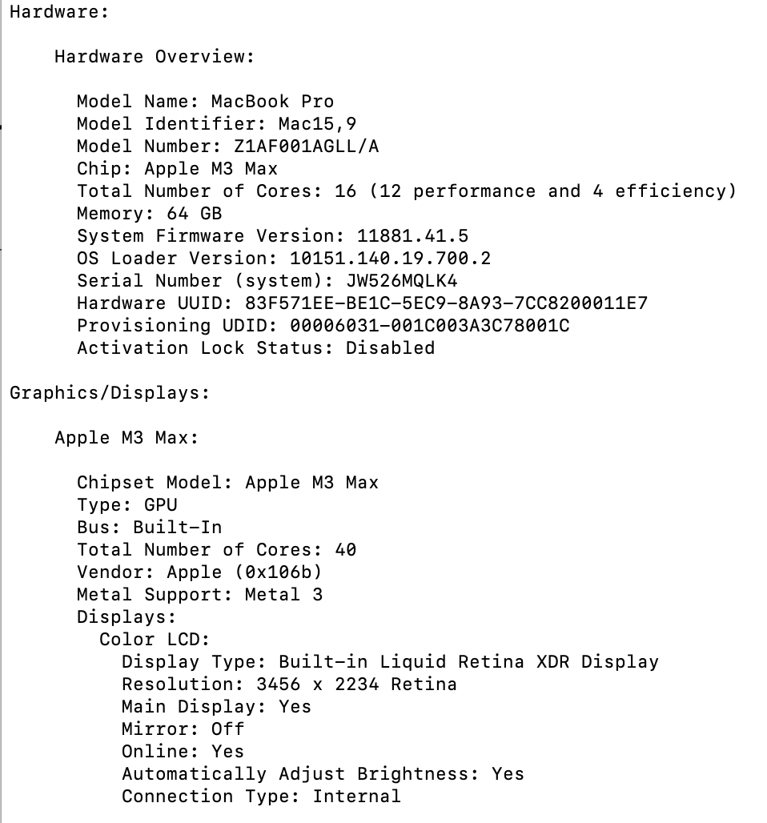
Implementation Platform
M3 Mac (At this time)
Details shown on the right
CARC (Work to go)
Singularity container
31 16-Cores
AMD EPYC 7302
256 GB RAM
AWS (Work to go)
Docker container
Will attempt to match the capability of CARC

Slide 23
Success Criteria
Evaluate the validity of speedup gains by comparing the result against theoretical bounds
Efficiency of the algorithm stays within a feasible boundary
Serial and Parallel implementation produces equivalent result (accuracy of the verification, compared with the ground truth)

Slide 24
Preliminary Result – Overall Comparison:
Threads | Execution Time (hh:mm:ss) | CPU Usage Peak (%) | CPU Usage Mean (%) | Memory Usage Peak (%) | Memory Usage Mean (%) | Total Disk I/O (MB) | Total Network Usage (MB)
1 | 05:09.7 | 47.9 | 14.42 | 77.1 | 70.63 | 34.82 | 38.44
2 | 05:19.8 | 59.2 | 15.02 | 78.8 | 70.01 | 26.99 | 46.26
4 | 04:47.6 | 43.9 | 11.5 | 76.5 | 69.36 | 22.38 | 38.5
8 | 04:53.6 | 29.9 | 14.41 | 77 | 70.01 | 39.97 | 33.97
16 | 05:37.9 | 51.2 | 13.2 | 77.6 | 69.67 | 32.95 | 39.42
4 (n=1) | 04:47.6 | 43.9 | 11.5 | 76.5 | 69.36 | 22.38 | 38.5
4 (n=2) | 09:53.0 | 41.7 | 15.5 | 77.6 | 70.55 | 67.78 | -550.85
4 (n=1) | 02:12.8 | 37.9 | 21.33 | 73.1 | 65.83 | 41.05 | 697.17
4 (n=2) | 03:41.2 | 46.6 | 14.78 | 75.2 | 66.93 | 8.38 | 65.98
4 (n=4) | 05:27.7 | 46.2 | 13.22 | 76.3 | 68.27 | 12.13 | 78.67
Average Number of Toke Processed: 34735

Slide 25
Preliminary Result – Increasing the # of Thread
Increasing the # of Thread resulted in performance gain up til 4 to 8.
Average Number of Toke Processed: 34735

Slide 26
Preliminary Result – Increasing the # of Thread
Increasing the # of cores resulted in linear performance degradation.
Average Number of Toke Processed: 34735

Slide 27
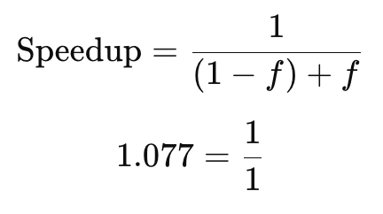
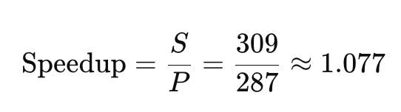
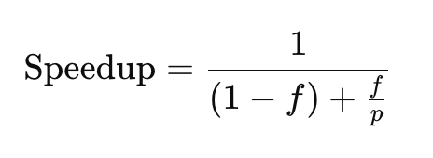
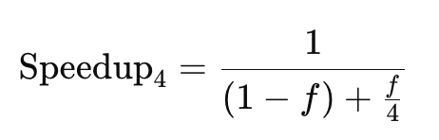
Conclusion
Comparison with theoretical bound (Amdahs’s Law)
When P = 2, f = 1.077
When P = 4, f = 0.148
2
2

Slide 28
Conclusion
No significant gain from this particular parallel implementation
Algorithm re-design or workload reconstruction is necessary
The results are consistent with the theoretical bound
Accuracy of the validation stayed consistent
Bottleneck is max {model’s inference time_{i}}
Work to go:
Program behavior as number of input token scales on CARC and AWS
Revisit C++ parallel program implementation
Compare KV-Cache parameter on/off differences

Slide 29
Thank you!

Slide 30
References 1
Yixuan Weng, Minjun Zhu, Fei Xia, Bin Li, Shizhu He, Shengping Liu, Bin Sun, Kang Liu, Jun Zhao, Large Language Models are Better Reasoners with Self-Verification, Findings of the Association for Computational Linguistics: EMNLP 2023
Tian-Xiang Sun, Xiang-Yang Liu, Xi-Peng Qiu, and Xuan-Jing Huang. 2022. Paradigm shift in natural language processing. Machine Intelligence Research, 19(3):169–183.
Yixuan Weng, Minjun Zhu, Fei Xia, Bin Li, Shizhu He1, Shengping Liu, Bin Sun, Kang Liu, Jun Zhao, Large Language Models are Better Reasoners with Self-Verification, Findings of the Association for Computational Linguistics: EMNLP 2023, pages 2550–2575
Chi-Min Chan, Weize Chen, Yusheng Su, Jianxuan Yu, Wei Xue, Shanghang Zhang, Jie Fu, and Zhiyuan Liu. 2023. Chateval: Towards better llm-based evaluators through multi-agent debate. arXiv preprint arXiv:2308.07201 (2023).

Slide 31
References 2
Prasanna, Victor 2024. "EE/CSCI 451: Parallel and Distributed Computation Lecture #13." Department of Computer Science, University of Southern California, October 15. https://piazza.com/class_profile/get_resource/lzucri269tu70c/m2f67i9s3zs2ec.
Prasanna, Victor 2024. "EE/CSCI 451: Parallel and Distributed Computation Lecture #14." Department of Computer Science, University of Southern California, October 17. https://piazza.com/class_profile/get_resource/lzucri269tu70c/m2f67i9s3zs2ec.
Wickramasinghe, Sachini 2024. "EE/CSCI 451: Introduction to Parallel and Distributed Computation Discussion #6." University of Southern California, October 8. https://piazza.com/class_profile/get_resource/lzucri269tu70c/m2f67i9s3zs2ec.
Liang, Percy, Rishi Bommasani, Tony Lee, Dimitris Tsipras, Dilara Soylu, Michihiro Yasunaga, Yian Zhang, et al. “Holistic Evaluation of Language Models.” arXiv, October 1, 2023. https://doi.org/10.48550/arXiv.2211.09110.
Wu, Qingyun, Gagan Bansal, Jieyu Zhang, Yiran Wu, Beibin Li, Erkang Zhu, Li Jiang, et al. “AutoGen: Enabling Next-Gen LLM Applications via Multi-Agent Conversation.” arXiv, October 3, 2023. http://arxiv.org/abs/2308.08155.

Slide 32
References 3
Prasanna, Victor 2024. "EE/CSCI 451: Parallel and Distributed Computation Lecture #13." Department of Computer Science, University of Southern California, October 15. https://piazza.com/class_profile/get_resource/lzucri269tu70c/m2f67i9s3zs2ec.
Prasanna, Victor 2024. "EE/CSCI 451: Parallel and Distributed Computation Lecture #14." Department of Computer Science, University of Southern California, October 17. https://piazza.com/class_profile/get_resource/lzucri269tu70c/m2f67i9s3zs2ec.
Wickramasinghe, Sachini 2024. "EE/CSCI 451: Introduction to Parallel and Distributed Computation Discussion #6." University of Southern California, October 8. https://piazza.com/class_profile/get_resource/lzucri269tu70c/m2f67i9s3zs2ec.
Liang, Percy, Rishi Bommasani, Tony Lee, Dimitris Tsipras, Dilara Soylu, Michihiro Yasunaga, Yian Zhang, et al. “Holistic Evaluation of Language Models.” arXiv, October 1, 2023. https://doi.org/10.48550/arXiv.2211.09110.
Wu, Qingyun, Gagan Bansal, Jieyu Zhang, Yiran Wu, Beibin Li, Erkang Zhu, Li Jiang, et al. “AutoGen: Enabling Next-Gen LLM Applications via Multi-Agent Conversation.” arXiv, October 3, 2023. http://arxiv.org/abs/2308.08155.

Slide 33
References 4
David Culler, Richard IQ, Abhijit Sahay, Klaus Erik Schauser, Eunice Santos, Ramesh Subramonian, and Thorsten von Eicken
“LogP: Towards a Realistic Model of Parallel Computation,” n.d., Computer Science Division, University of California Berkeley
Barbic, Jernej. “Multi-Core Architectures,” 15-213, 2007, May 3rd https://www.cs.cmu.edu/~fp/courses/15213-s07/lectures/27-multicore.pdf
“PJM - System Operations.” Accessed October 9, 2024. https://www.pjm.com/markets-and-operations/ops-analysis.
Barbic, Jernej. “Multi-Core Architectures,” n.d.
“Stanford Large Network Dataset Collection.” Accessed October 9, 2024. http://snap.stanford.edu/data/index.html.

Slide 34
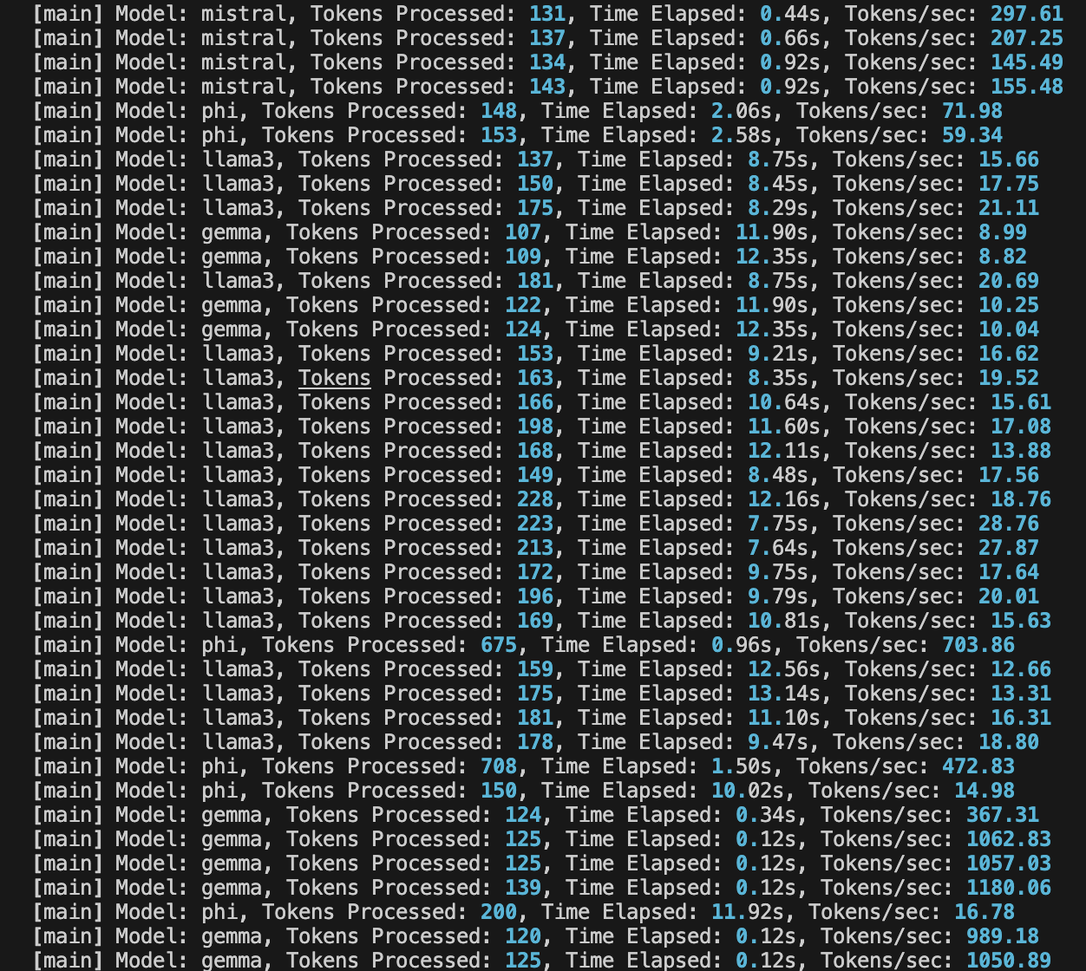
Overflow

